Slide 1
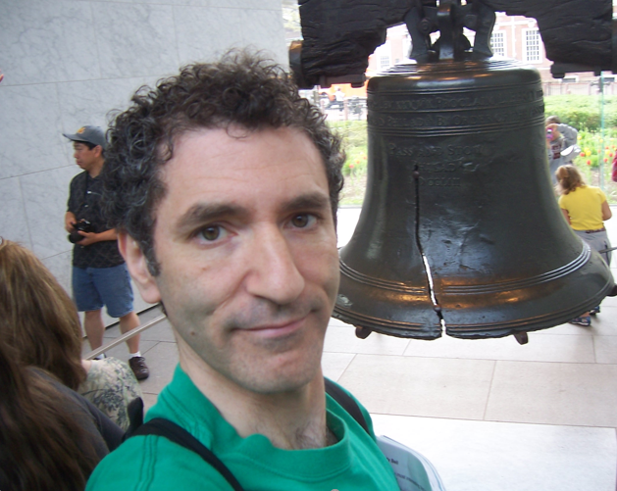
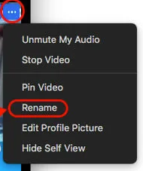
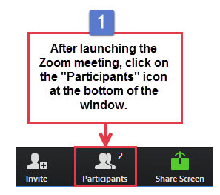
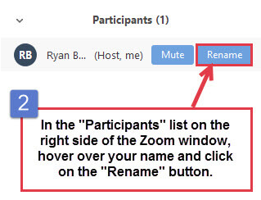
HI! Please “Rename” yourself with one of these prefixes:
CIT MENTOR FORUM November 9, 2020
ART_ Visual Art
BIL_ Bilingual Elementary
CSL_ Counselors
PRI_ Elementary K-3
INT_ Elementary 4-6
ENG_ English
ENL1_ ESOL/ENL Elementary
ENL2_ ESOL/ENL Secondary
FOR_ Foreign Language
LIB_ Library/Technology
MAT_ Math
MUS_ Music
PEH_ Phys Ed/Health
PRK_ Elem Pre-K
PSY_ Psychologist
REA_ Reading
SCI_ Science
SST_ Social Studies
SWK_ Social Worker
SWD1_ Sp Ed Elem K-3
SWD2_ Sp Ed Elem 4-6
SWD3_ Sp Ed 7-12
SPE_ Speech
SST_Stefan
OR
This will help us to assign “Breakout Rooms” later.
Example: “SST_Stefan”
Please turn off your video (“Stop Video”) when you don’t need it. That reduces the amount of data going in and out of the computer.

Slide 2
CIT MENTOR FORUM November 9, 2020
Tech issues during this Zoom meeting? Please email
Anna.Leone-Tobar@rcsdk12.org .
Please turn off your video (“Stop Video”) when you don’t need it. That reduces the amount of data going in and out of the computer.
Notes:
Tech issues during this Zoom meeting? Please email Anna.Leone-Tobar@rcsdk12.org.

Slide 3
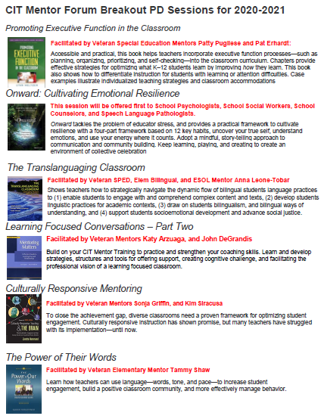
CIT Mentor Breakout PD Sessions Monday, November 16th @ 4:00 P.M.
Activated Mentors attend today’s Mandatory CIT Mentor Forums (Whole Group)
AND Mandatory CIT Mentor Forum Breakout PD Sessions (next Monday, Nov 16)
If not activated, Mentors get PD Incentive Hours
Zoom Link sent by Breakout PD Session facilitator
Contact Annamaria.Manso@rcsdk12.org with questions.
Notes:
Annamaria Manso

Slide 4
CIT Support
CURRENT TOTALS as of September 17, 2020
INTERN: | 30
PS RESIDENT: | 43
PS TENURED: | 40
PS LT Sub | 10
TOTAL: | 123
You will be receiving a survey soon to help us know about your instructional tech expertise.
Notes:
Poll #1 – “CIT Mentor Remote Teaching Emotional Check-In”

Slide 5
CIT Mentor “Office Hours”
Stay tuned!
Topics may include . . .
Zoom Classroom Management Q & A
Completing Report Cards
IEP writing, Progress reports, Progress progress monitoring
Google classroom
Tech support (specific to platform: Google Classroom, Padlet, Flipgrid, Screencastify, etc.)
“I’m Overwhelmed!” (Time Management/Setting Priorities)
Self-care Strategies and Teacher Resilience
Engaging Students on Zoom
Managing Student Testing in Remote Environment
Modifying Curricula for SWD
Support with Implementing Differentiation Strategies in a Remote Learning Environment
Supporting Parents via Communication during Remote Learning
All Purpose Q & A

Slide 6
Visiting Teachers in the current Remote Teaching Environment
from September CIT Mentor Forum
When visiting a teacher’s Zoom classroom, introduce yourself to the students in a way that is comfortable for the teacher you are supporting (and co-teachers).
Use Danielson’s The Framework for Remote Teaching as a tool for support, not to give scores.
Prioritizes student well-being, equity, and racial justice
focuses on fewer components (updated)
reflection and conversation (language to use: not yet, in process, in place)
In lieu of a rubric, it outlines “priorities, actions, and strategies” for synchronous, and asynchronous engagement.

Slide 7
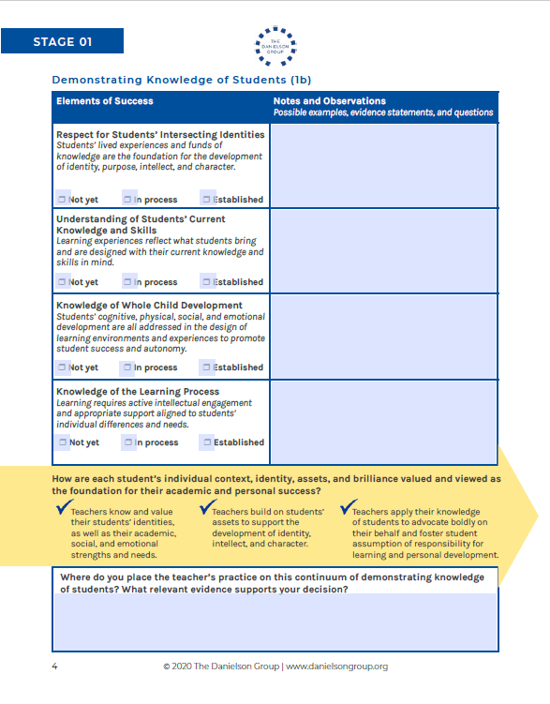
CIT Mentor Support in the Remote Teaching Environment
What does effective practice in these conditions look like?
In your BREAKOUT ROOMS, take this opportunity to discuss the characteristics of high quality practice that we want to see and encourage as mentors and in our own work.
Using the Danielson Group’s Framework for Remote Teaching “Observation Tool,” you will share specific examples that demonstrate if an element is “established” or not.
Notes:
“Please be patient” as we sort into Breakout Rooms; Paste bullets into Chat

Slide 8
CIT Mentor Support in the Remote Teaching Environment
What does effective practice in these conditions look like?
Once you are in your Breakout Rooms:
Select ONE Mentor in your room to use the link in the Chat, open the shared Google Doc, and “Share Screen” with your group.
On your assigned page in the shared Google Doc, generate specific examples of what it looks like when an element from the Danielson tool is effectively “Established” and what it looks like when it is not.
You may wish to refer to the Danielson Remote Framework and “tools” using the link in the Google Doc.
Notes:
Once you are in your Breakout Rooms:
Select ONE Mentor in your room to use the link in the Chat, open the shared Google Doc, and “Share Screen” with your group. https://docs.google.com/document/d/1JPTDvUWE094lBZLbIkWDD_RK_GyeuiQj6s8Ai103rc4/edit?usp=sharing
On your assigned page in the shared Google Doc, generate specific examples of what it looks like when an element from the Danielson tool is effectively “Established” and what it looks like when it is not.
You may wish to refer to the Danielson Remote Framework and “tools” using the link in the Google Doc.
Danielson Framework and Tools: https://drive.google.com/drive/u/1/folders/1jRhFpvM2r-GcYVK0q-yZ-b6RlkC_YIUn

Slide 9
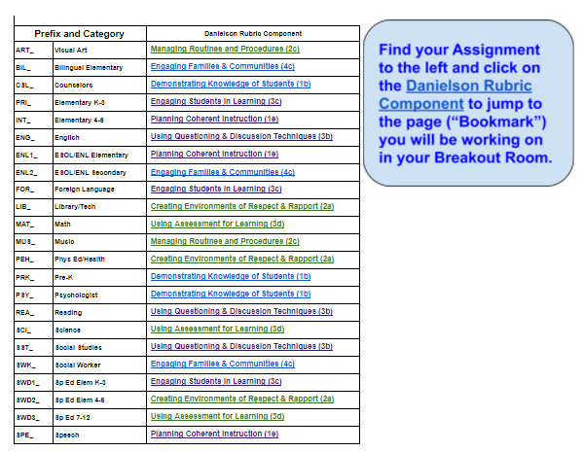
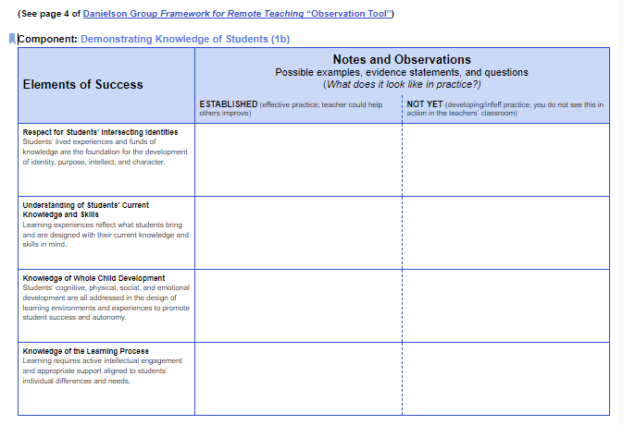
CIT Mentor Support in the Remote Teaching Environment
What does effective practice in these conditions look like?
Notes:
“Please be patient” as we sort into Breakout Rooms; Paste bullets into Chat.
You will not be the only breakout room typing on that page. Please select a text color to distinguish your Breakout Room’s contributions from the other people typing on that page.
Once you are in your Breakout Rooms:
Select ONE Mentor in your room to use the link in the Chat, open the shared Google Doc, and “Share Screen” with your group. https://docs.google.com/document/d/1JPTDvUWE094lBZLbIkWDD_RK_GyeuiQj6s8Ai103rc4/edit?usp=sharing
On your assigned page in the shared Google Doc, generate specific examples of what it looks like when an element from the Danielson tool is effectively “Established” and what it looks like when it is not.
You may wish to refer to the Danielson Remote Framework and “tools” using the link in the Google Doc.

Slide 10
Gallery Walk through Google Doc
When you get a chance, visit the “Danielson Remote Teaching Evidence” Google Doc and add your comments using the “Add Comment” tool.
Debrief if time allows
(in the chat or raise hand)
How was the discussion process for you?
Did you find common issues? Any surprises?
Please complete the evaluation survey after the Forum.
Notes:
POLL Two – “CIT Mentor Remote Teaching Emotional Check-Out”

